Slide 1

contact@softyeducation.com

Slide 2
Day 0

Slide 3
Content :
1- Introduction
2- Why Python ?
3- How to Follow Along
4- Install Python and vscode
5-Write the first program

Slide 4
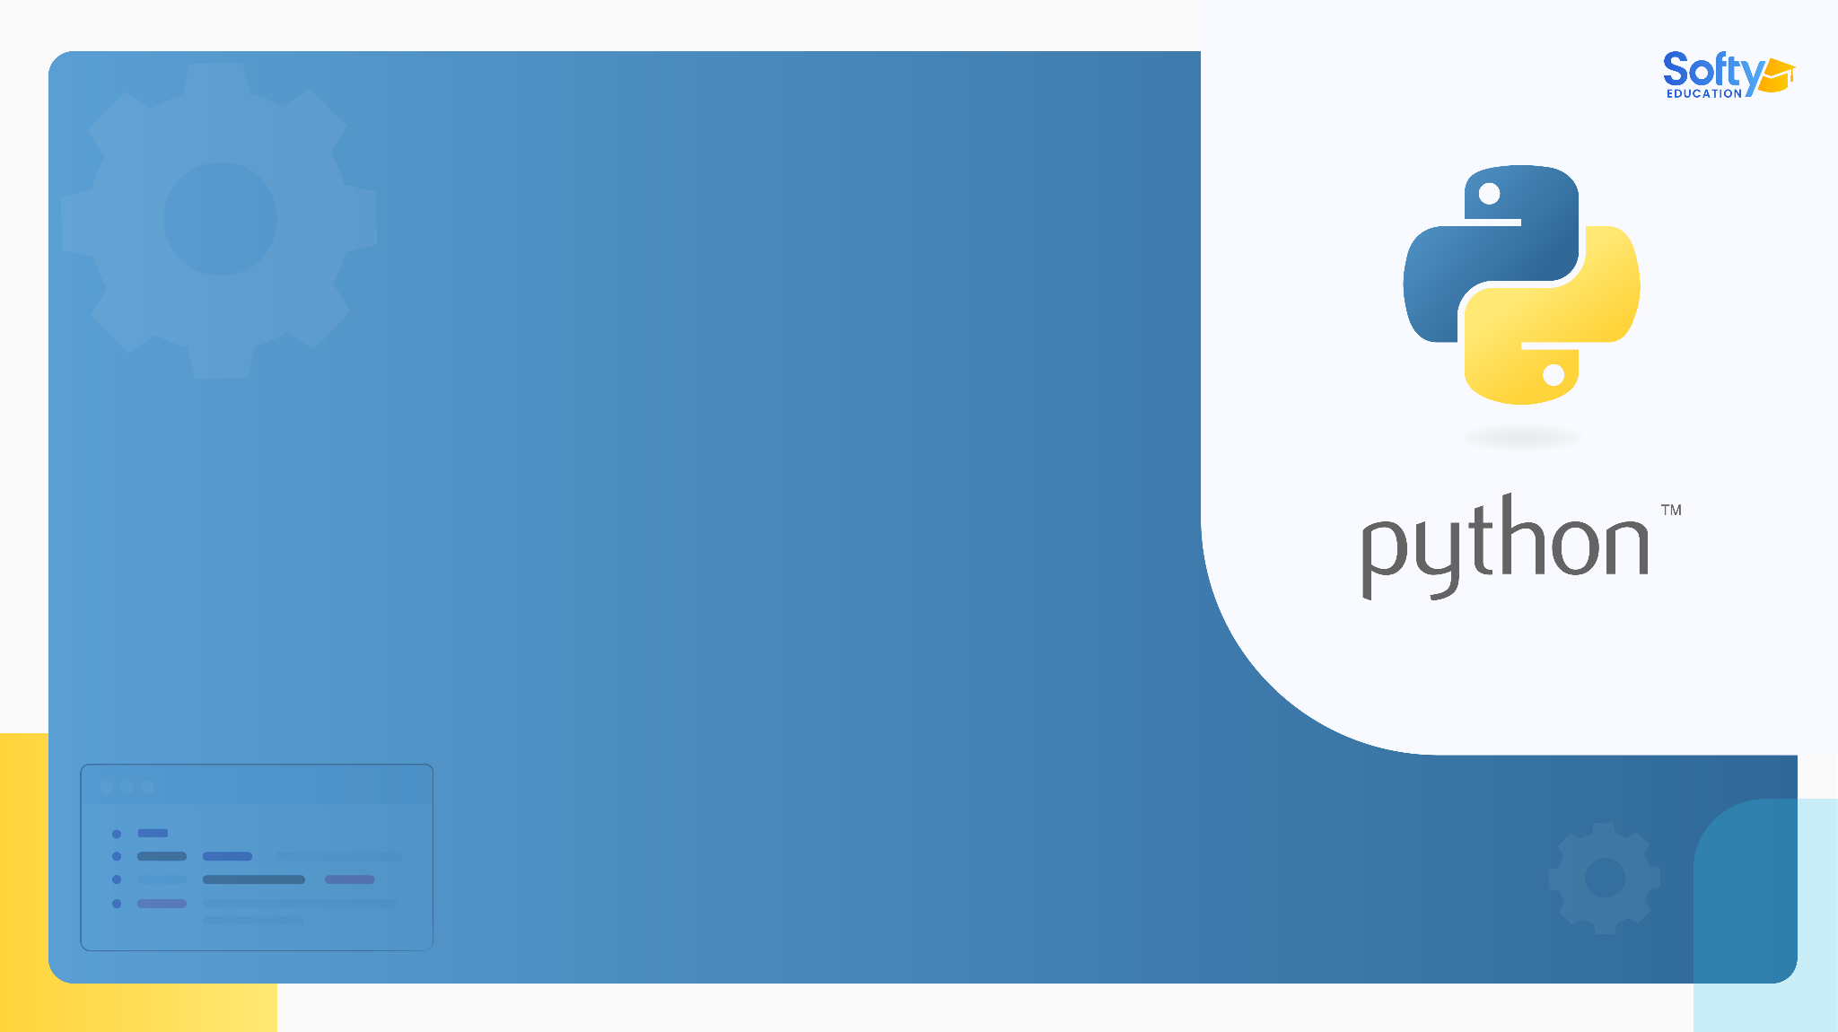
01
Introduction

Slide 5



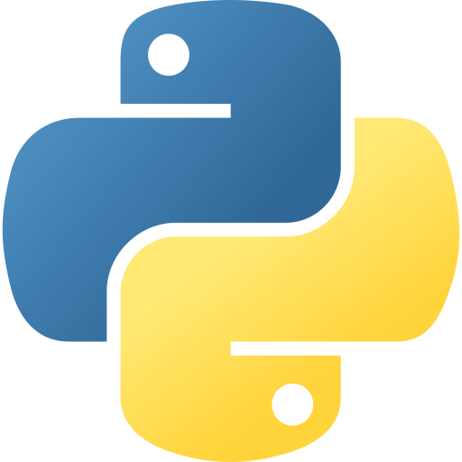


01- Introduction
Web Development
Artificial Intelligence
Automation
‹#›
Data science

Slide 6









02- Popular apps built with Python

Slide 7
02
Why Python ?

Slide 8
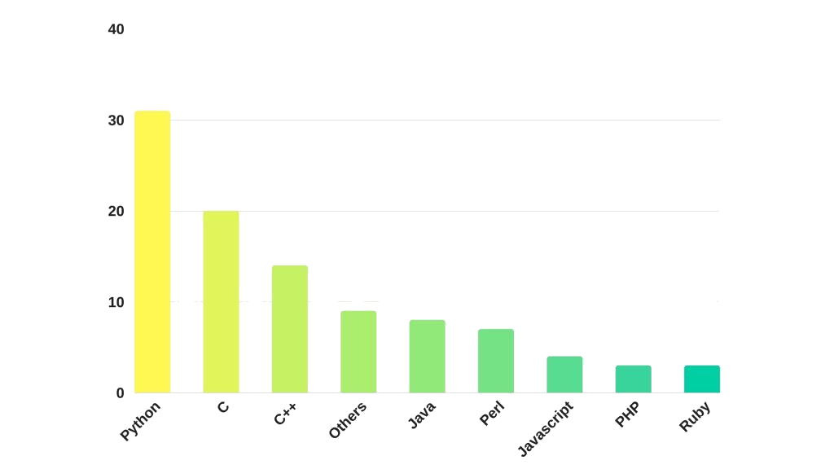
03- Why Python ?

Slide 9
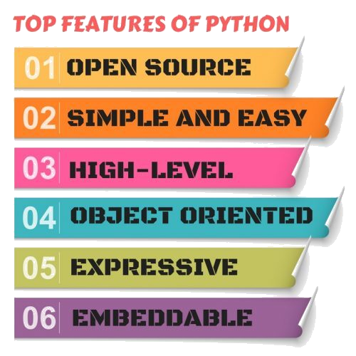
03- Why Python ?

Slide 10
03
How to Follow Along

Slide 11


03- How to Follow Along
This course focuses on learning through practical application.
Make sure to type the code snippets you encounter in the course instead of copying and pasting them. Typing the code yourself will help you understand the concepts better and grasp the syntax faster.

Slide 12


03- How to Follow Along
Don't worry if you make mistakes; it's completely normal and happens to all developers daily. Correcting typos and errors will teach you how to debug your code effectively.

Slide 13

03- How to Follow Along
Try to solve the review exercises and code challenges independently before seeking help from external sources. With enough practice, you'll become proficient in the material and enjoy the learning journey!

Slide 14
04
Install Python and vscode

Slide 15
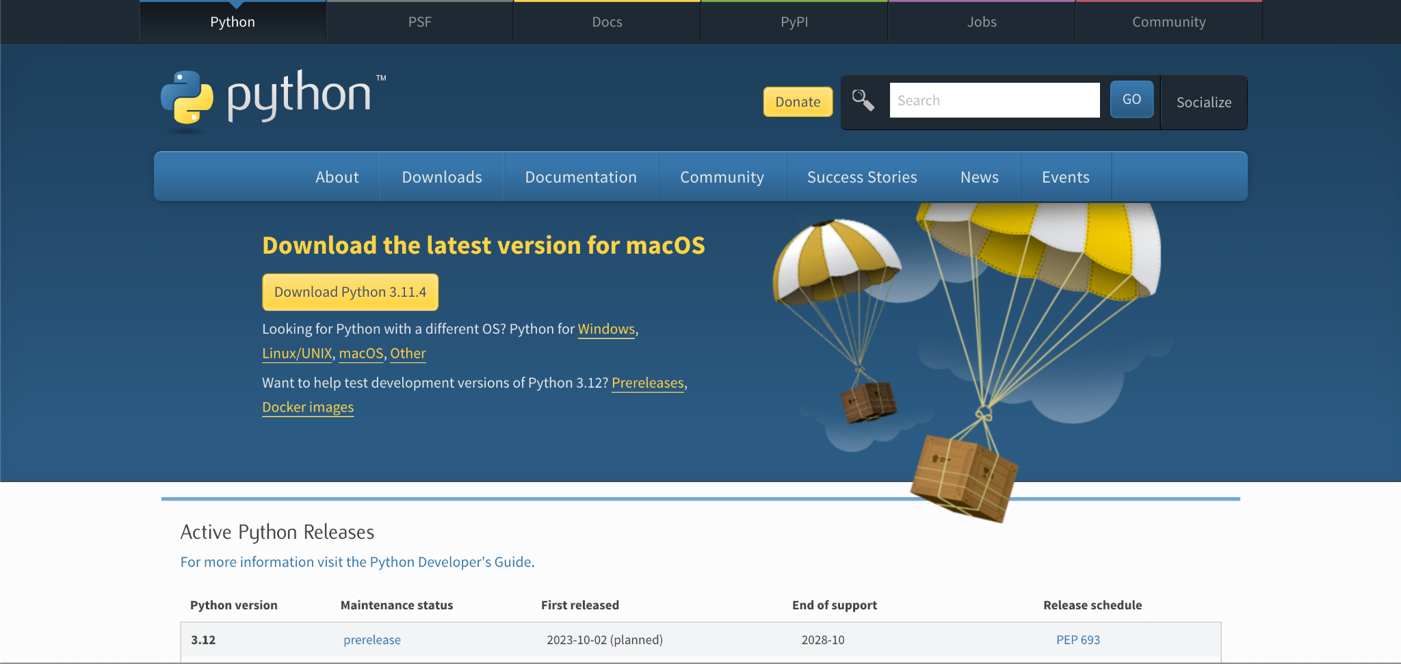
04- Install Python and vscode
Installing Python 3 is straightforward and requires only a few additional steps. Once installed, you can access Python from anywhere on your system and use its built-in package manager to install the software.
Open a browser to the Python website (https://www.python.org/) and download the installer.

Slide 16
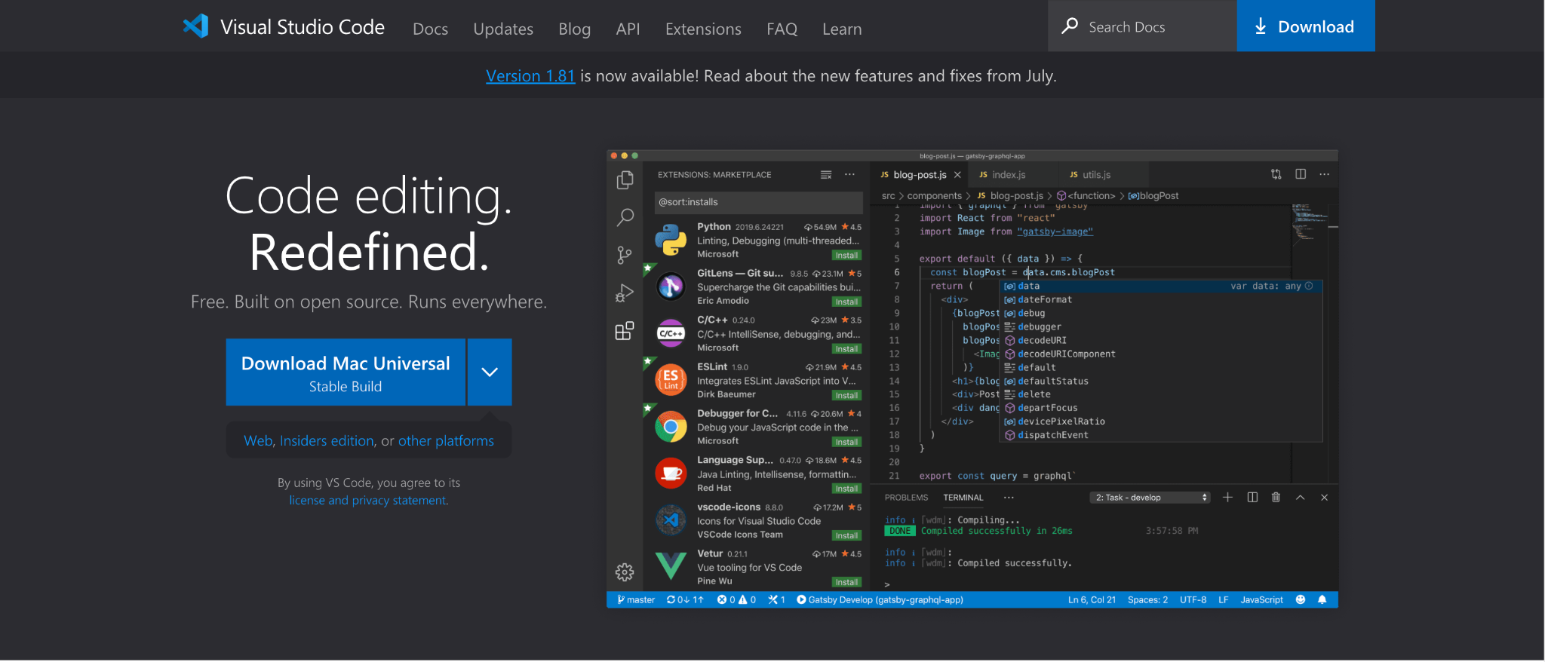
04- Install Python and vscode
We will use Visual Studio Code to edit the code .
Visit this site to download it (https://code.visualstudio.com/) .

Slide 17
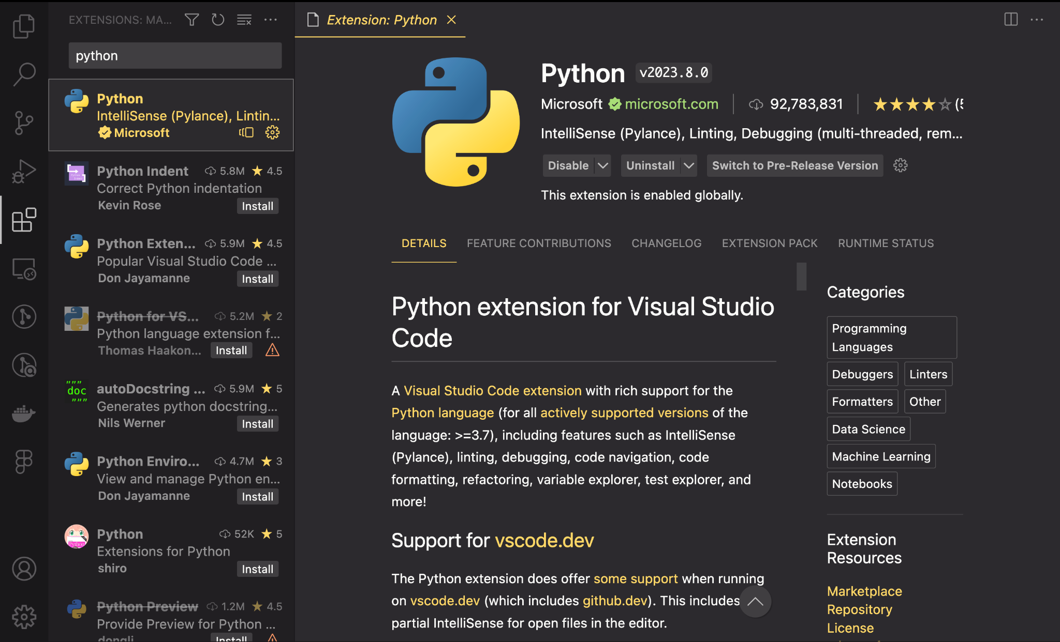
04- Install Python and vscode
To use VS Code with Python, follow these simple steps :
1. Go to the Visual Studio Marketplace and install the Python extension.

Slide 18
05
Write the first program

Slide 19
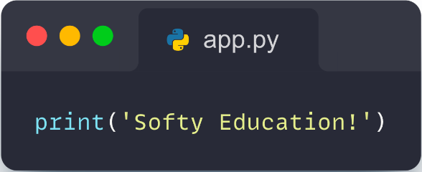
05- Write the first program
To begin with the first program we should follow these instructions :
1. Create a new folder called "softy_education".
2. Open Visual Studio Code and navigate to the "softy_education" folder.
3. Inside the folder, create a new file named "app.py".
4. Copy and paste the following code into "app.py":

Slide 20
Thank you

